Slide 1

DOM manipulation
By
BJIT Academy
Image Placeholder

Slide 2

What is Web API?
API stands for Application Programming Interface.
Example
A Server API can extend the functionality of a web server.
A Browser API can extend the functionality of a web browser.
“https://dummyjson.com/products”
“https://dummyjson.com/users”
A Web API is an application programming interface for the Web.

Slide 3
Using the Fetch API
The Fetch API provides a JavaScript interface for accessing and manipulating parts of the protocol, such as requests and responses.
It also provides a global fetch() method that provides an easy, logical way to fetch resources asynchronously across the network.
A basic fetch request looks like this:
async function logMovies() {
const response = await fetch("https://dummyjson.com/products");
const movies = await response.json();
console.log(movies);
}

Slide 4
The DOM Programming Interface
The following example changes the content (the innerHTML) of the <p> element with id="demo":
The HTML DOM can be accessed with JavaScript (and with other programming languages).
In the DOM, all HTML elements are defined as objects.
The programming interface is the properties and methods of each object.
A property is a value that you can get or set (like changing the content of an HTML element).
A method is an action you can do (like add or deleting an HTML element).
<html>
<body>
<p id="demo"></p>
<script>
document.getElementById("demo").innerHTML = "Hello World!";
</script>
</body>
</html>

Slide 5
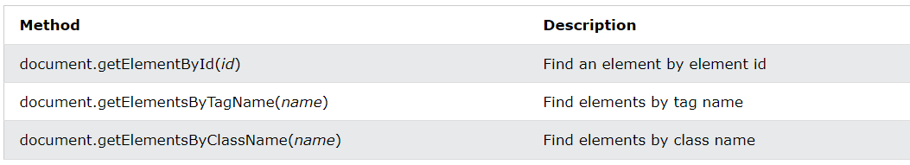
Finding HTML Elements

Slide 6
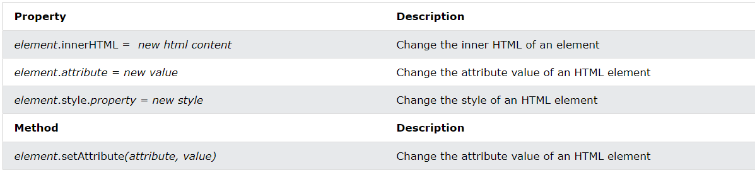
Changing HTML Elements

Slide 7
Finding HTML Elements
Finding HTML elements by class name
Finding HTML elements by id
Example
const element = document.getElementById("intro");
Example
const x = document.getElementsByClassName("intro");
Finding HTML elements by tag name
Finding HTML elements by CSS selectors
Example
const element = document.getElementsByTagName("p");
Example
const x = document.querySelectorAll("p.intro");

Slide 8
Finding HTML Elements
Finding HTML elements by HTML object collections
Changing HTML Style
Example
const x = document.forms["frm1"];
let text = "";
for (let i = 0; i < x.length; i++) {
text += x.elements[i].value + "<br>";
}
document.getElementById("demo").innerHTML = text;
To change the style of an HTML element, use this syntax:
document.getElementById(id).style.property = new style

Slide 9
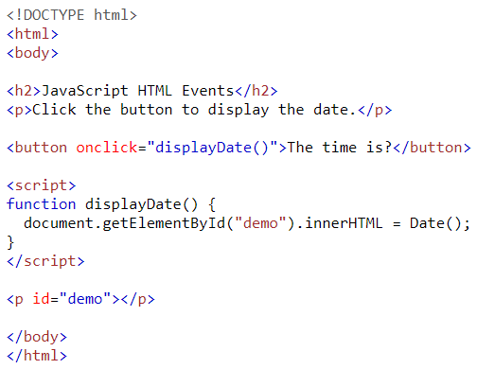
JavaScript HTML DOM Events
Examples
Examples of HTML events:
When a user clicks the mouse
When a web page has loaded
When an image has been loaded
When the mouse moves over an element
When an input field is changed
When an HTML form is submitted
When a user strokes a key

Slide 10
JavaScript HTML DOM EventListener
Example:
The addEventListener() method attaches an event handler to the specified element.
The addEventListener() method attaches an event handler to an element without overwriting existing event handlers.
You can add many event handlers to one element.
Alert "Hello World!" when the user clicks on an element:
element.addEventListener("click", myFunction);
function myFunction() {
alert ("Hello World!");
}
element.addEventListener("mouseover", myFunction);
element.addEventListener("click", mySecondFunction);
element.addEventListener("mouseout", myThirdFunction);

Slide 11
JavaScript HTML DOM Elements (Nodes)
Creating New HTML Elements (Nodes)
Example:
<div id="div1">
<p id="p1">This is a paragraph.</p>
<p id="p2">This is another paragraph.</p>
</div>
<script>
const para = document.createElement("p");
const node = document.createTextNode("This is new.");
para.appendChild(node);
const element = document.getElementById("div1");
element.appendChild(para);
</script>
To add a new element to the HTML DOM, you must create the element (element node) first, and then append it to an existing element.

Slide 12
Thank You
Image Placeholder

